Slide 1

How to strengthen the mind towards resilience with buddhist psychology
how to cultivate positive qualities of the mind and reduce antagonists

Slide 2
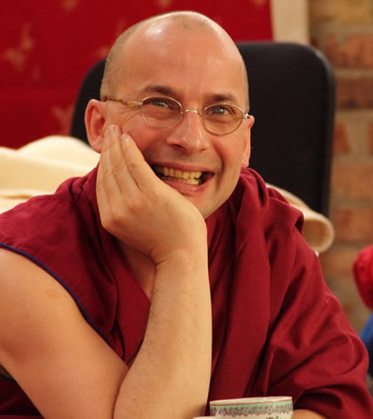
Tenzin Peljor
Tibetan Buddhist monk (ordained by H.H. the Dalai Lama, India)
Graduate of the FPMT‘s Masters Program in Buddhist Studies (Italy)
Graduate of the Mindfulness Teacher Certification Program by Tara Brach & Dr. Jack Kornfield (USA)
Pre-Diploma Computer Science (Germany)
Post-gradual Study of Theatre Education (Germany)
Working with kids, young people, prisoners, drug addicts – with a focus on emotion regulation
Local and international teacher based in Germany leading different Buddhism in-person and online study and meditation programs
Specialized in dynamics of religious cults

Slide 3

happiness oR suffering IS EXPERIENDED BY THE MIND.
Mind is formost.

Slide 4
A good understanding of how the mind functions is crucial for finding ways to experience Happiness and to reduce the experience of suffering.
If mind is formost, the knowledge about dynamics of the mind and how to alter mind states is essential
It’s like having an axe at hand when wanting to cut trees,
Or to have the knowledge how to cultivate a beautiful garden that can be enjoyed

Slide 5
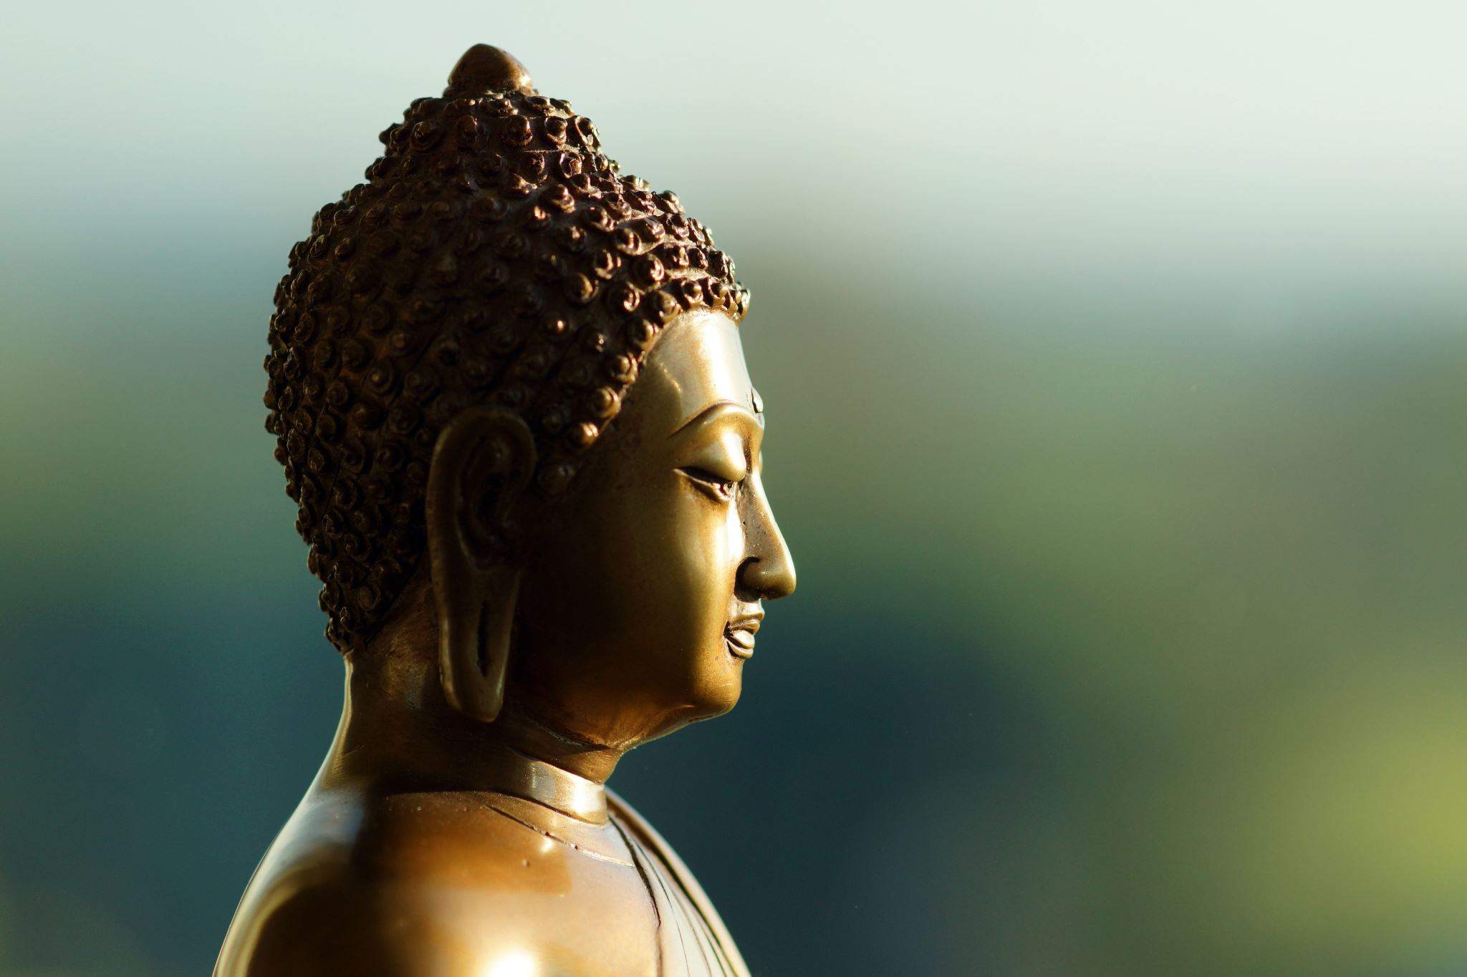
Buddhist psychology

Slide 6
Mind is formost
The Mind perceives and shapes
what we are
what and how we experience
the world we perceive and respond to
You need a mind to
Think of a house
Visually see a house
Distinguish it (own or other)
Name it a house
Create a house
Maintain a house
Feel how you feel in the house
Notes:
The understanding in Buddhism is that what we are, what we experience, the world we perceive and respond to is all perceived and shaped by the mind.
You need a mind to think of or to visually see a house. You need a mind which distinguishes a house you own from another one’s house you don’t own.
The name house depends on the mind, the creation of the house depends on the mind (the initial virtual and later drawn constructions of the architect, as well as a motivation of the workers to come day by day to really build and finish the house) – all of it, including the maintenance of the house, depend on the mind which has a motivation to do this.
Also how you feel in the house depends on the mind. And different people with different mindsets will perceive and experience the house differently. Someone whose wishes are now fulfilled to have an own roof – maybe having lacked it for a long time – might feel so grateful and happy to live now in the house. Another one might see all the construction faults and abide in a mode of complaining about the construction firms. Another one might just feel unwell and cannot explain why etc. And everyone entering and living in the house will come with her or his own backpack of past experiences and schematas which shape the experiences been made in the house.

Slide 7
Mind is formost
What CAN and CAN’T be controlled
Events outside a person’s mind are difficult to control
But HOW one relates to events can be chosen
The freedom to choose can be learned
The Mind Changes
Like everything in this world the mind is subject to change
Humans generally prefer pleasant states of mind and avoid unpleasant states of mind
Notes:
So, that’s why the Buddha says that mind is foremost. While events outside a person’s mind very often can’t be controlled and unfold – as it often seems – rather arbitrary, how one relates to such events, is understood in Buddhism as a matter of choice. A choice one can learn.
And mind changes. The person who initially felt gratitude and happiness, might later feel bored or uncomfortable. The person having felt unwell initially might get so attached to the house and living there, that she or he feels horror to even imagine to have to leave it one day.

Slide 8
Searching for happiness
Wherever Mind is involved
There is a wish to be happy (or to experience wellbeing)
And a wish to not suffer (i.e. freedom from suffering, not to experience discomfort, pain or trouble)
This is a REALITY
Be AWARE of it
Find ACCEPTANCE of it
Notes:
Besides this understanding within Buddhism there is another view on life which is an investigation and conviction that wherever mind is there is a wish to be happy (or to experience wellbeing) and a wish to not suffer (or not to experience discomfort, pain and trouble).

Slide 9
Searching for happiness
  ACCEPTANCE:
  Accept your natural desire to be happy: Like a mother lovingly holds her child → cherishing one’s own longing to be happy
  This forms the RELATIONSHIP
  to oneself
  to others
  Thereby creates COMPASSION for
  oneself
  others
  → To perceive suffering and the desire to find freedom from suffering

Slide 10
Mental happiness
  Mental happiness and freedom from mental suffering
  is more important than
  Material happiness and freedom from material suffering
  A pleasant feeling tone (skt. vedanā) and an unpleasant feeling tone can be experienced by all six main minds
  → five senses consciousnesses
  → mental consciousness
Notes:
Usually there is the understanding of six main minds in Buddhism, the five sense consciousnesses and the mental consciousness. Happiness and suffering, joy and sorrow can be experienced through all of them.
The Dalai Lama stressed, mental happiness is more important than material happiness. Why? Imagine a Sunday morning in your family and you feel bad, depressed, unsatisfied or somewhat aggressive: all the richness of your life, the full refrigerator, your health, to have an good income, a place to live etc. cannot overwrite your mental state of sorrow, lamentation or feeling bad. All the material things that can induce happiness or a joy won’t work. While if you get up Sunday morning with a happy state of mind, with joy, you have a power to deal even with a limited material situation. Less or nothing in the fridge, ok, the mind will find a solution or might feel happiness to have at least something little (better than nothing) etc.
A joyful, happy mind can overwrite poor material or troubling outer conditions. To give an extreme example: Brother David Steindl-Rast, a Benedictine monk from Austria, also a psychologist who holds a PhD, recollected recently in a TV interview that he and his friends in their youth were more happy during the Second World War time than after World War II after most of the difficult and life threatening conditions settled and a stable status quo gradually has had established. The reason, he said, was, in war time the death was always “in front of their eyes,” death was so close so that every moment was experienced far more precious and special. So being in touch with the present moment, not been stuck in past and future worries, and seeing the preciousness of the here and now based on the closeness of death caused him and his friends one of their most happiest times. These are states of minds. Others, of course, have experienced horror, trauma and a heavy burden. Also these experiences are mind states.
https://youtu.be/3rLNALMh_yk?si=jG8m9CnsP6TG1Soc

Slide 11
Causes for happiness
  Causes for happiness and freedom from suffering can be
  detected
  analyzed
  WHOLESOME MENTAL STATES
  are causes for
  (mental) happiness, inner peace
  Now and in the future
  UNWHOLESOME MENTAL STATES
  are causes for
  (mental) unhappiness, inner conflict and suffering
  Now and in the future
Notes:
To give you an example: affection and aversion; rejoicing and envy [example been shared and explained with the audience]
Now imagine, in your mind are more states of affection than aversion or more of rejoicing then envy. What does this cause for yourself, how will your world feel? And what effects will this have to the people you encounter or work with?
So, you can safely conclude, the more wholesome mental states are within a person’s mind the more peace and happiness she / he can experience. The more unwholesome mental states are within a person’s mind the more inner conflicts and sufferings a person will experience.

Slide 12
Mini-max-principle
  INCREASING wholesome mental states
  and
  DECREASING unwholesome mental states
  is part of the spiritual endeavor (effort, skt. vīrya)

Slide 13
Mini-max-principle
  Effort (“joyous perseverance”) encompasses four activities
  1) to prevent the initial development of destructive mental states (which have not yet manifested in the psyche)
  2) to abandon the destructive mental states that have already manifested in the psyche
  3) to cultivate constructive mental states (initiate and build up healthy mind resources)
  4) to maintain such constructive mental states (strengthen the healthy mind and subsequently build up resilience by doing so).
Notes:
You might want to replace the terms “wholesome/unwholesome” by “constructive/destructive” or “strengthening/weakening” mental states or “qualities of mind” and “conflict causing emotions” etc.

Slide 14
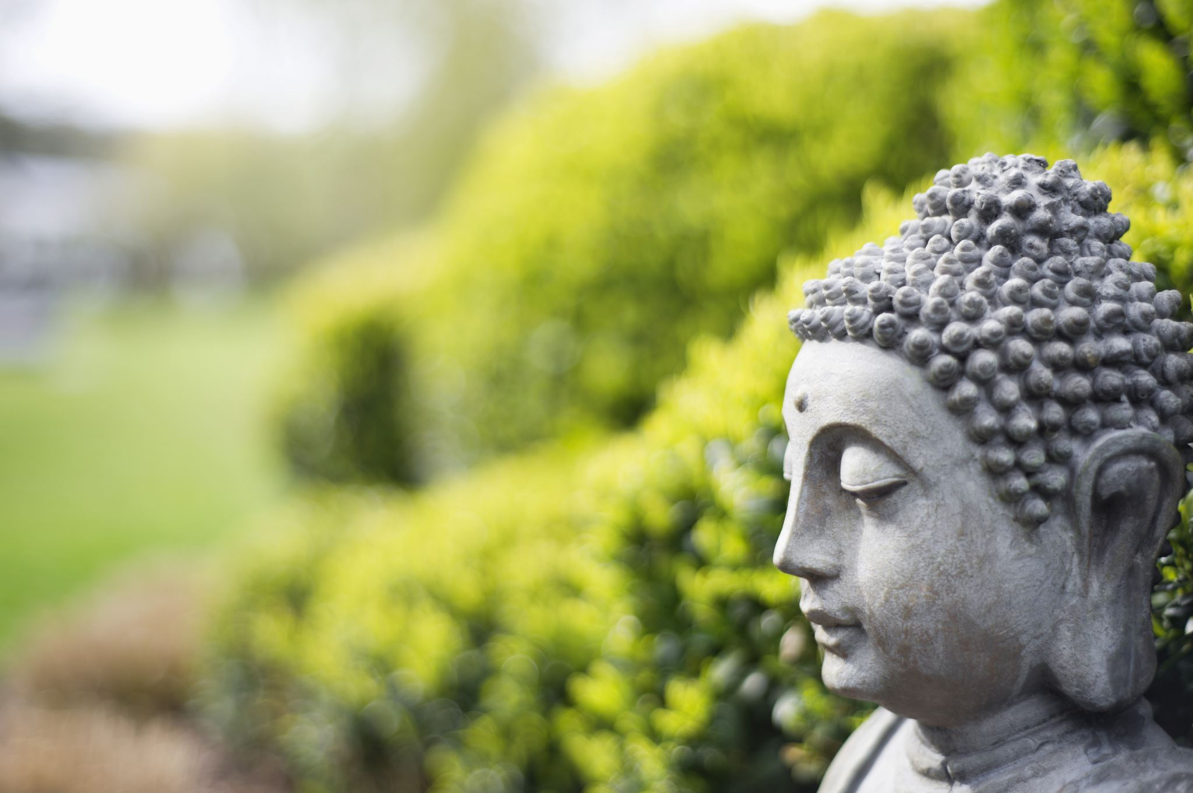
What are wholesome (destructive) and unwholesome (destructive) mental states?
Notes:
Buddhist psychology has some suggestions and it’s a matter of investigation or rational analyses to check what your view will be on that and if you can make use of this century old “inner science”.

Slide 15
Buddha
It is said, the Buddha used to say “ehipasiko” which means “come and see for yourself”.
Notes:
I’d like to invite you to check and see for yourself the following explorations.

Slide 16

Three groups of qualities
Notes:
From the very many qualities of the mind that cause inner peace, resilience, strength, happiness and joy been explained, investigated, and meditated on within Buddhism you can summarize these into three categories as Ullrich Ott, (Psychologist, Bender Institute of Neuroimaging an der Universität Gießen) has presented it

Slide 17
Three groups of qualities
Collecting the mind (skt. samādhi) & Mindfulness (skt. smṛti)
Focused
Attentive
Open awareness
Constructive/Heart Qualities
Loving Kindness, Compassion, gratitude etc.
Values, Perceptions, Beliefs
De-Constructive
Insight through analysis of object/subject
Non-Dualism
Notes:
The last group I will not cover. While methods that increase de-constructing skills can be also very helpful in a therapeutic context – it includes perspective changes, reflections on impermanence or a “dynamic” self, and the deconstruction of burdensome mental patterns so that they lose their grip over oneself – they can be also destabilizing for a person who needs more stability.
Let’s make this now juicy and lets use some examples

Slide 18
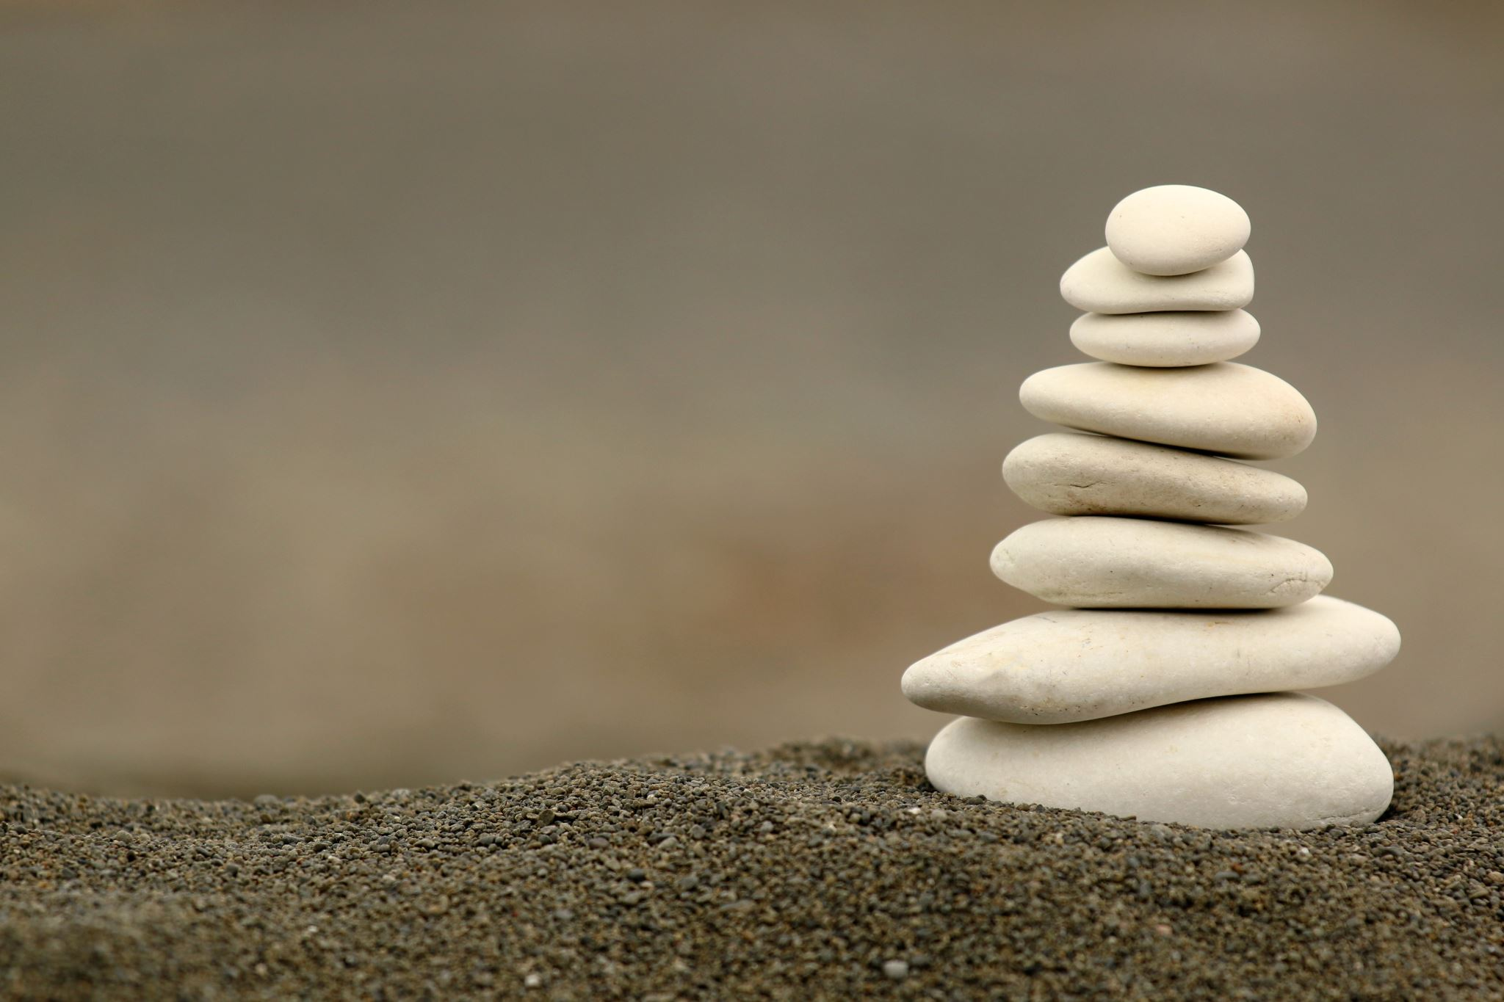
mindfulness

Slide 19
mindfulness
There are different definitions and understandings of mindfulness!* Most known is that of Kabat-Zinn.
“Right Mindfulness”: “And what, monks, is right mindfulness? Here, a monk dwells contemplating the body in the body, ardent, clearly comprehending, mindful, having removed covetousness and displeasure in regard to the world. … This is called right mindfulness.”*
Basically mindfulness (skt.: smṛti) and clear comprehension (or introspection, skt. samprajñāna) should coexist.
Based on both mental qualities can be
cultivated,
strengthened
nourished
* see: “Is Mindfulness Present-Centered and Nonjudgmental? A Discussion of the Cognitive Dimensions of Mindfulness” by Georges B. Dreyfus
* DN 22.21 (II 313; LDB 348-49). MN 141.30 (III 252; MLDB 1100-1101). SN 45:8 (V 9-10; CDB 1529)
Notes:
Mindfulness in broader sense

Slide 20
mindfulness
Mindfulness in broader sense unites different mental processes:
The process of mindfulness (skt.: smṛti)
The process if introspection or awareness (skt. samprajñāna)
Both form a basis i.e. for the mental quality of “concentration” (collecting the mind, uniting the scattered mind, skt. samādhi).
Notes:
Many of these qualities are already known and also applied in modern day psychology which uses mindfulness methods – e.g. MBSR and its derivates (MB Eat), MBCT etc.

Slide 21
mindfulness
How does mindfulness feel?
open,
receptive
soft,
being present,
clear,
peaceful,
spacious
calm,
flexible,
alive,
centered,
subtle joy
Realms of Mindfulness
internal, external, both
Notes:
Many of these qualities are already known and also applied in modern day psychology which uses mindfulness methods – e.g. MBSR and its derivates (MB Eat), MBCT etc.

Slide 22
mindfulness
Mindfulness based Stress Reduction (MBSR), J. Kabat-Zinn
Mindfulness based Cognitive Therapy (MBCT), Z.V. Segal
Mindfulness based Relapse Prevention (MBRP), S.Bowen
Mindfulness based Eating Awareness Training (MB-eat)
Minfulness based childbearth and parentin program (MBCP)
Notes:
Many of these qualities are already known and also applied in modern day psychology which uses mindfulness methods – e.g. MBSR and its derivates (MB Eat), MBCT etc.

Slide 23
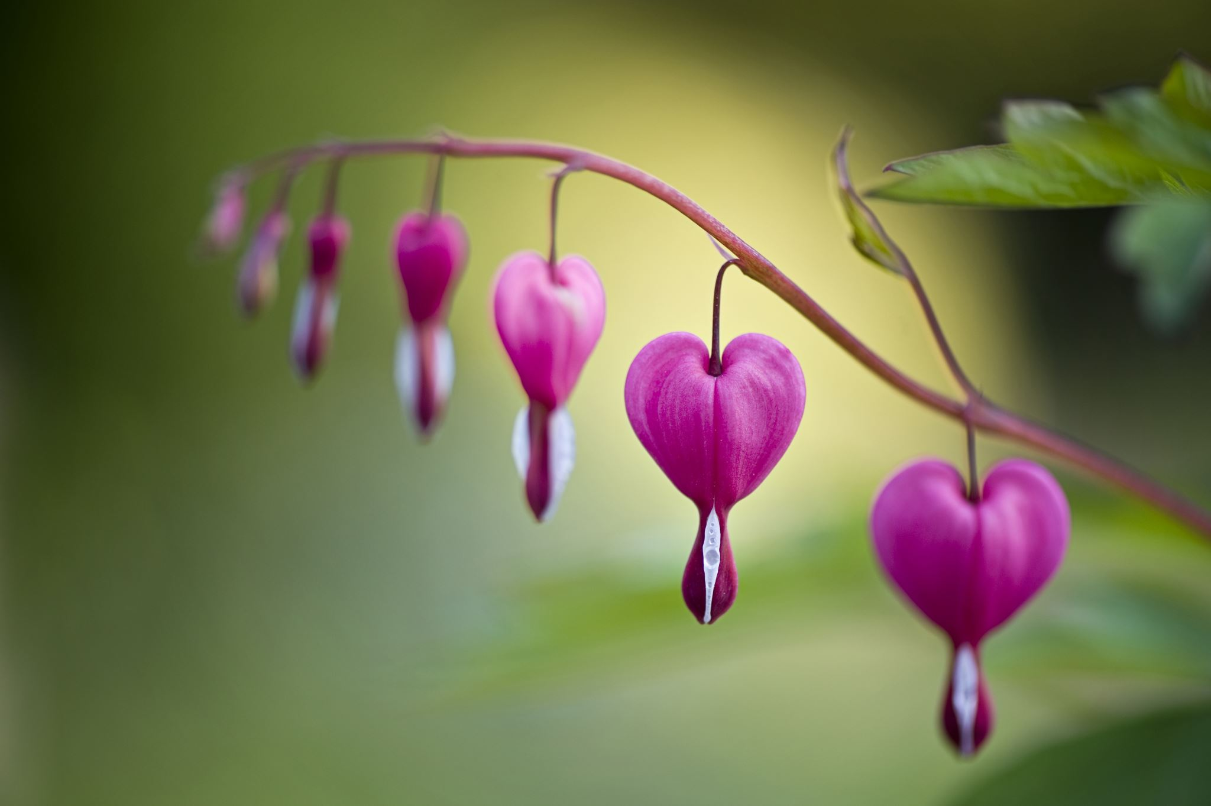
The heart qualities
Notes:
From here on l’ll focus on the second group mentioned by Ott which I would call “exercises for the development of the heart” or maybe just “exercises for healthy relationships to oneself and others” – please change and rename this category as you see fit.
Some of the qualities in that group are already established in the therapeutic field such as the metta-meditation (loving kindness), the cultivation or training in gratitude, compassion training etc.

Slide 24
The heart qualities
Loving Kindness, Compassion
  Metta-Meditation
  Compassion-Focused Therapy (CFT), P. Gilbert
  Mindful Self-Compassion (MSC), K.Neff, C.Germer
  Mindfulness based Compassionate Living (MBCL), E.v.d.Brink, F.Koster
Values, Beliefs
  Acceptance and Commitment Therapy (ACT), S.Hayes
Notes:
MSC is a stand alone training, MBCL is a follow up on the MBSR

Slide 25
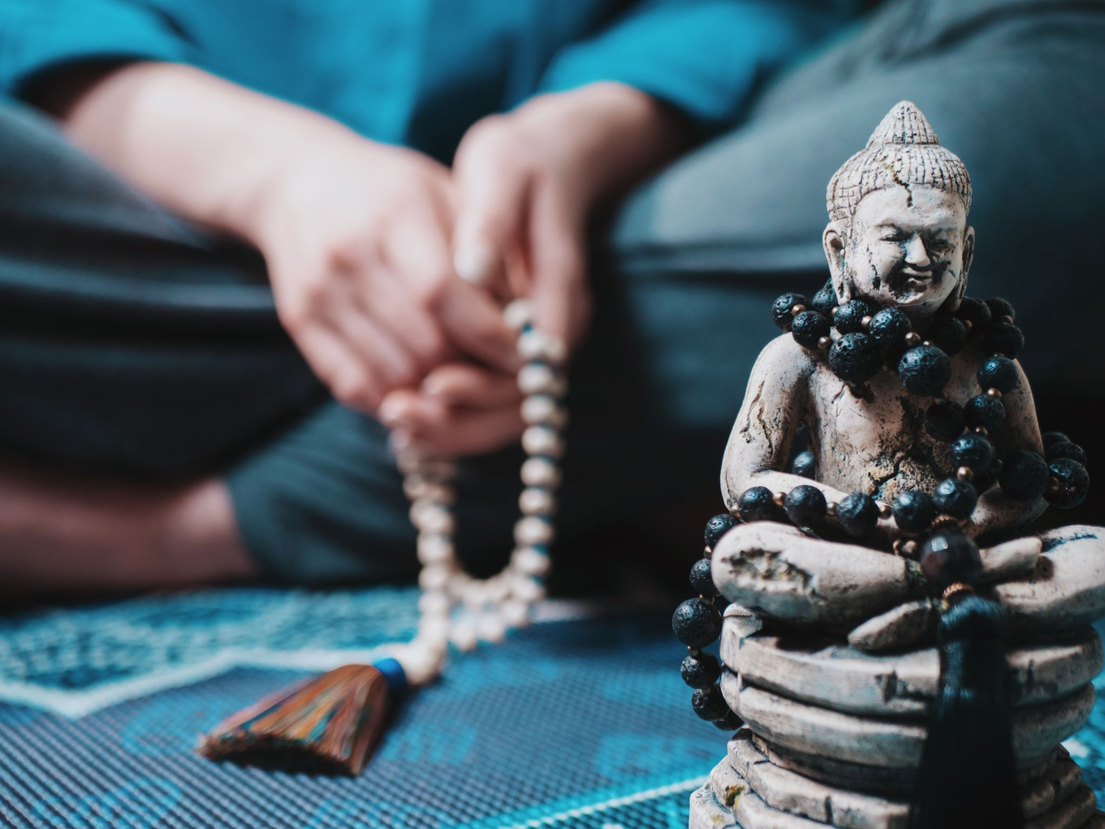
Training the qualities

Slide 26
Training the qualities
each mind quality has an antagonist.
Or each antagonist has a countering quality
Notes:
Basic principle of training the qualities is to train the quality and to beware of the antagonist in the mind

Slide 27
Qualities and antagonists
Love vs. Hate
Rejoicing vs. Envy
Cherishing Attitude vs. Lacking Cherishing Attitude
Patience (Peaceful Acceptance) vs. Anger
  being able to be in peace with pain and difficulties vs. intolerance with uncomfortable feelings → ACT
Gratitude vs. Taking Everything as Granted (or being in a constant complaining mode)
No Greed/Letting go of Greed vs. Greed
Contentment vs. Greed
Understanding vs. Ignorance (→Hannah Arendt: “I want to understand!”)
Intelligence vs. Not Comprehending Things
Wisdom vs. Ignorance
Compassion vs. Cruelty

Slide 28
Qualities and antagonists
Affection vs. Aversion
Generosity vs. Stinginess
Wholesome Motivation vs. Unwholesome Motivation (medical doctor earning money / helping patients)
Joyous Perseverance vs. Sloth / Laziness
Faith (in trustworthy things) vs. (excessive) Disbelief (in trustworthy things)
Trusting One’s Intuition vs. Not Trusting One’s Intuition
Humility vs. Pride
Ethical Orientation vs. Non-Ethics
Self-Discipline vs. Lack of Self-Discipline
Mental Pliancy vs. mentally Harsh or Tied Attitude
Tolerance vs. Intolerance
Indulgence vs. Revenge/Grudge
Forgiveness vs. Revenge/Grudge
Consciousness vs. Non- Consciousness
Authenticity vs. Incongruency regarding one’s values or inner being
Respect vs. Disrespect

Slide 29
Qualities and antagonists
Shame vs. Non-Shame (complex topic, healthy sense of shame vs. toxic shame)
Concentration (Flow, Collecting the mind) vs. Distractions (Being inwardly scattered and in States of Unrest)
Openness vs. Close Mindedness
Impartiality vs. Partisan Attitude
Letting Go vs. Clinging
Composure/Serenity vs. Tight Fistedness
Bravery vs. Insecurity (complex!)
Truthfulness vs. Deceptiveness
Honesty vs. Lying and Deception
Being Self-Aware vs. Not Being Self-Aware [mindfulness & introspection]

Slide 30
Qualities and antagonists
Being Relaxed vs. Not Being Relaxed
Humor vs. Taking Oneself and Things too Seriously
Introspection (Self-Awareness) vs. Non-Introspection (Lack of Self-Awareness)
Mindfulness vs. Non-mindfulness
Loose Self-Centredness vs. Tight Self-Centredness
Being Able to Admit Faults vs. Hiding Faults
…
there are far more qualities, eg. Helpfulness, Creativity, Curiosity, Inner Fulfillment…

Slide 31
Three groups of qualities aiming
to increase the heart qualities
For a calm, peaceful mind / a joy to be in the present moment
to deconstruct complex and fixing inner patterns
Notes:
These mental qualities and their opponents can be grouped into the three categories as presented by Ullrich Ott, aiming either
1) for a calm, peaceful mind / a joy to be in the present moment,
2) to increase heart qualities – which include methods for self-acceptance, self-love but also reducing strong egoistic patterns, love and compassion for other, gratitude, forgiveness etc.
3) to deconstruct complex and clinging inner patterns.

Slide 32

Four heart qualities: brahmavihĀras
(devine abodes)
Notes:
Here I want to stress four heart qualities that increase the healthy modes in relating to oneself and others. In Buddhism they are called the Brahmaviharas (devine abodes) and are:

Slide 33
compassion (pali: karuna) love (loving kindness, in the sense of wishing well being) (pali: metta) rejoicing (sharing joy) (pali: mudita) equanimity (pali: upekkha)
Notes:
Each of these mental qualities has a direct opposing power (“far enemy”) where you feel the exact opposite of the mental quality (i.e. hate instead of love). And each of these mental qualities has a “near enemy” – meaning, it feels like the mental quality but is not really the very quality (i.e. pity instead of compassion // or emotional empathy vs compassion ).
(Note, There is also a difference between emotional empathy as understood in neuroscience and compassion!. See: “Differential pattern of functional brain plasticity after compassion and empathy training”, Olga M Klimecki, Susanne Leiberg, Matthieu Ricard, Tania Singer. https://pubmed.ncbi.nlm.nih.gov/23576808/)

Slide 34
DirectLY opposing powers vs. “untrue qualities” (feel like proximity)
BRAHMAVIHARA | NEAR ENEMY | FAR ENEMY
Compassion | Pity | Cruelty
Love | Selfish attachment (clinging) | Hate (Ill Will)
Rejoicing | Exuberance | Envy
Equanimity | Indifference | Craving, Clinging
Notes:
Each of these mental qualities has a direct opposing power (“far enemy”) where you feel the exact opposite of the mental quality (i.e. hate instead of love). And each of these mental qualities has a “near enemy” – meaning, it feels like the mental quality but is not really the very quality (i.e. pity instead of compassion).
(Note, there is also a difference between empathy as understood in neuroscience and compassion!)

Slide 35

training
Success to cultivate a specific quality depends on training
Regular
Like building of physical muscle
Mental Qualities are „muscles of the mind“
Regular practice can be Mental Gym
Notes:
The success in cultivating a specific quality depends on a regular training – just like the building of physical muscles depend on a regular training. Qualities are “muscles for the mind” and a regular training, like a meditation practice, is the mental gym that increase the “mental muscles.”

Slide 36
Two types of training
a formal and at best regular meditation practice* and
daily live in which the mental specific quality one wants to increase is applied
* or other methods that cause familiarization (like visualizations, role plays etc., also reading/hearing or thinking about, discussing such qualities)
Notes:
Other, modern day methods, for mental training can include improvisation theater or theater pedagogic based methods where a given situation is been acted out and the skillful methods can be applied and tested.
Further, the success to increase healthy mental qualities depends on the skill to identify and to work with the antagonistic power of a given quality. With respect to the latter, therefore methods for dealing with “destructive emotions” – the antagonistic powers – are very useful. Shortly I’ll mention four methods known to me and with which I work for myself or in prison and in courses for the public.

Slide 37

motivation

Slide 38
motivation
Reflecting and recollecting the benefits of the quality
Reflecting and recollecting the benefits of getting more freedom from the tight grip of the antagonistic power of that quality
Notes:
Before one undertakes any training, motivation is important. A reflection and recollection of the benefits of the quality and the benefits of getting more freedom from the tight grip of the antagonistic power, of that quality is a common method in Buddhism to keep the mind on the track (or in training).

Slide 39

Loving kindness
Secular meditation practices
Applied when wanting to raise or increase that quality
Regular
2-5 minutes already helpful
Daily live application
Spontaneously
Through lens of that quality
Regular
3-10 attempts daily
Notes:
To cultivate a nourishing quality such as loving kindness, there are secular meditation practices – e.g. by Tara Brach or Jack Kornfield (both psychologists). These can be applied by a person who wants to raise or increase that quality of as loving kindness in a formal meditation practice. (2-5 minutes would be already very helpful!) Then in daily live, when one meets a friend or is at a queue at the supermarket one applies the method again to bring it into one’s daily life and to shape daily life by that quality – or seeing the world through the lens of that quality. One could attempt to 3-10 (or more attempts) daily to reactivate that quality briefly (or for a longer period) in daily life situations. (It’s a bit like some bodybuilders who see a bar and immediately use it to do some pull ups.)
For some people it might be more difficult to give loving kindness to oneself, for others it might be more difficult to give loving kindness to a nasty person, a close but hated relative etc. That’s all part of the training but one should not lay the bar too high! It needs a gradual approach and one starts with were it is easy! It’s about getting familiar with the taste of the quality, to raise, nourish and increase it. It’s not about making it hard for oneself. So what ever is easy there one starts.
See the additional material from the MMTCP training

Slide 40

Far enemy: hate
Wish to harm (incl. Schadenfreude)
(or envy)
Take a mindful step back
Watch the feeling’s
  Arising,
  Feel it,
  Learn to be with it
Contemplate
  Is that what I want?
  Is that feeling in line with my values?
Notes:
The far enemy of loving kindness is hate, the wish to harm. So, to get more aware of feelings of hate (which include Schadenfreude) and then to take a mindful step back watching at that feeling when it arises, feeling it, being with it, one could ask oneself: “Is it that what I want?” Is that feeling in line with my values (or psychological / spiritual aims)?

Slide 41
Far enemy: hate
If answer is NO
  →Underlying insight →
  Reluctance to follow through →
  Initiate process of Letting go
  or
  Arising curiosity of how to let go (not being held slave by it any longer)
Reflections and recollections of the demerits of the unwholesome mental state
Wisdom by Insight → POWER TO LET GO! ☺
Notes:
If there is a clear answer to that question, like “No!”, the underlying insight and the reluctance to follow thar hate will initiate a process of either letting go the hate immediately or it might form into a wish to get rid of it (or to get more freedom from its grip) sooner or later. Also a curiosity how to get rid of that feeling (in the sense that it does not hold oneself as its slave) could arise which can activate further investigative / learning processes or creativity to be more capable to deal with hate.
You could call the ability to let go of hate by mindfully observing it as “a letting go based on insight” – or “an insight that forms a power to renounce hate”.
Similar as with the qualities were you reflect and recollect the benefits of the quality, here you can do reflections or recollections of the demerits of that unwholesome mental state of hate (or the antagonistic power to the quality). The insight is a wisdom that understands the demerits more clearly, and has a conviction that it is just so, and this wisdom can give the power for letting hate go (or for letting go of envy or any antagonistic power).
(A side note: Reflecting the demerits of antagonistic powers, carefulness is needed to not develop hate over hate or anger over anger or being disappointed or unhappy when envy arises. Whatever arises can be welcomed as a teacher and can be used for one’s inner growth.)

Slide 42

Summary of way for cultivating qualities
1. reflecting or recollecting the merits or demerits of a quality and its counter force
2. cultivating the quality through a formal (regular if possible) meditation practice (or similar methods for familiarization)
3. applying the quality in daily life (setting specific aims where and when one wants to reactivate / train the quality)
4. learning to detect the antagonistic force of the quality and then working skillfully with it in order to loosen its grip on oneself
5. in the evening one could recapitulate the own training, rejoicing in where it worked, reconsidering why / where it didn’t work and forming a motivation to train again the next day.
6. In the morning, while waking up, one could remember one’s training, make a strong determination to use the day to continue the training and one could make a dedication “May my training be successful and may this quality increase like the waxing moon – in myself and others. …”
Alternatively, journaling and other methods, like visualizations or role games etc. which are already used – for instance in gratitude trainings – can be used here too.
Notes:
reflecting or recollecting the merits or demerits of a quality and its counter force
cultivating the quality through a formal (regular if possible) meditation practice
applying the quality in daily life (setting specific aims where and when one wants to reactivate / train the quality)
learning to detect the antagonistic force of the quality and then working skillfully with it (there are different methods, see the list at the end) in order to loosen its grip on oneself
in the evening one could recapitulate the own training, rejoicing in where it worked, reconsidering why / where it didn’t work and forming a motivation to train again the next day. In the morning, while waking up, one could remember one’s training, make a strong determination to use the day to continue the training and one could make a dedication “May my training be successful and may this quality increase like the waxing moon – in myself and others. …”
Alternatively, journaling and other methods, like visualizations or role games etc. which are already used – for instance in gratitude trainings – can be used here too.

Slide 43

Four methods to deal with “counter forces”

Slide 44
Deal with quality hindrances / destabilizing emotional states
R.A.I.N. – Tara Brach
B.E.L.L.A. – Gil Fronsdal
Self Compassion – Kristin Neff / Chris Germer
Five Ways - Tilmann Borghardt & Wolfgang Erhardt
Notes:
Some of them are combining techniques of mindfulness with compassion, i.e. first and second group

Slide 45
R.A.I.N.
R ecognize what is happening
A llow the experience to be there, just as it is
I nvestigate with interest and care
N urture with self-compassion (alternatively non-identification)
Notes:
Tara Brach. Traumsensitive Achtsamkeit Travelen * Merkzettel Brach

Slide 46
B.E.L.L.A.
B e with it (not acting on it, not reacting to it)
E xamine (conditions that caused its arising and its dissolving)
L essen (the grip of it, soften the tension)
L et go
A ppreciate

Slide 47
Self-compassion
Neff:
This is a moment of suffering
Suffering is a part of life
May I be kind to myself in this moment
Germer:
The sympathetic gaze
The compassionate touch
Compassionate words

Slide 48
Five ways
pause mindfully in the emotion*
use appropriate tools
take a different view of the emotion
recognise the actual nature of the emotion
use stressful emotions as a pathway
* find a space between the emotion and the response

Slide 49

CULTIVATING INNER STRENGHS in a children mindfulness prorgamm
Notes:
Share qualities story with MFN course for kids. Boy “Leo” / mother psychotherapist.
Raisin exercise awakening the “super detective”; training to recognize new feelings and strengths, during the course, during the week, noting it down; reading the list and letting it actively acknowledge by the kids (note a strength can be a weakness in a certain situation, a strength can be still blocked but still a strength), effect it has had on the boy and the family life.

Slide 50

happiness
After all happiness is a question of choice between the discomfort to become aware of ones onwn mental afflictions and the discomfort to be controlled by those afflictions
(Yongey Mingyur Rinpoche)

Slide 51
THE SPACE
“There is a space between stimulus and reaction. In this space lies our power to choose our reaction. In our reaction lies our development and our freedom.”
(Viktor Frankl)

